Slide 1

Raspberry PI and AI Stream
ZAS
Academy
Dr. Roohi Banu
Mr. Fakruddin Mohammed

Slide 2
Day 2.
Raspberry PI - AI, ML, DL & RL Introduction
ZAS
Academy
Dr. Roohi Banu
Mr. Fakruddin Mohammed

Slide 3



Z A S A C A D E M Y
Raspberry PI - Machine and Deep Learning
(12 Weeks ADVANCED Course for Secondary & College Students)
@78 99 11 222 5
Week1
Week2
Week3
Week4
Week5
Week6
AI Introduction & ML/DL Life Cycle
Data Handling (Pandas & Numpy)
Data Handling & Visualization (matplotlib)
Probability & Statistics (Variable Selection)
Regression
Classification
Course content may be altered depending on participant needs & speed of grasping power
Week7
Week8
Week9
Week10
Week11
Week12
Artificial Neural Networks & Backpropagation
2 Layers Neural Networks & CNN Intuition
Deep Learning CNN & Raspberry PI
Deep Learning CNN & Raspberry PI
Deep Learning CNN & Raspberry PI
Deep Learning CNN & Raspberry PI
Live ZOOM Lectures from 14-Nov:
Natural Language Processing – NLP - ???
At the end of course participants will have
Thorough & deeper understanding of AI/ML/DL (Neural Networks)
Seen full end-to-end life cycle of Data Science Projects
Built at least 1 Deep Learning OBJECT DETECTION model from SCRATCH end-to-end and deploy on to PI

Slide 4

AI Introduction: Machine Learning
https://blogs.nvidia.com/blog/2016/07/29/whats-difference-artificial-intelligence-machine-learning-deep-learning-ai/

Slide 5
AI Introduction: Deep Learning
https://blogs.nvidia.com/blog/2016/07/29/whats-difference-artificial-intelligence-machine-learning-deep-learning-ai/

Slide 6
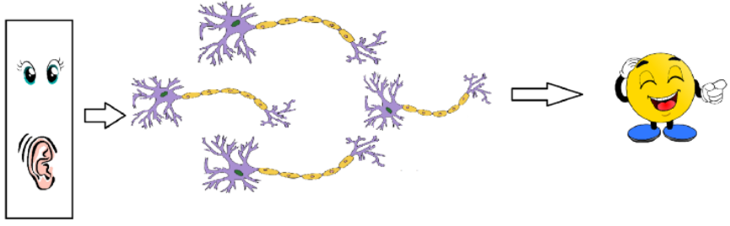
AI Introduction: Biological Neuron
https://medium.com/@jayeshbahire/the-xor-problem-in-neural-networks-50006411840b#:~:text=The%20XOr%2C%20or%20%E2%80%9Cexclusive%20or,value%20if%20they%20are%20equal.

Slide 7
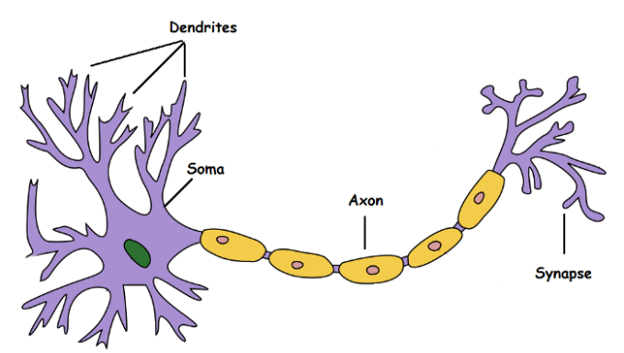
AI Introduction: Biological Neuron
Neuron Inputs
Processing
Other Neurons
Output
https://medium.com/@jayeshbahire/the-xor-problem-in-neural-networks-50006411840b#:~:text=The%20XOr%2C%20or%20%E2%80%9Cexclusive%20or,value%20if%20they%20are%20equal.

Slide 8
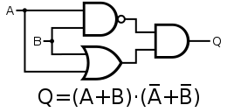
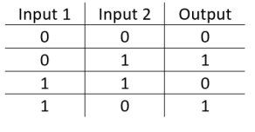
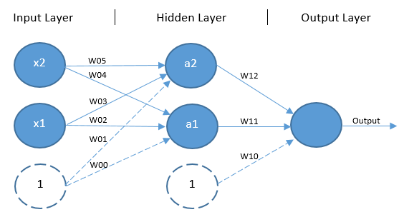
AI Introduction: Feed Forward Neural Network
https://medium.com/@jayeshbahire/the-xor-problem-in-neural-networks-50006411840b#:~:text=The%20XOr%2C%20or%20%E2%80%9Cexclusive%20or,value%20if%20they%20are%20equal.

Slide 9
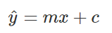
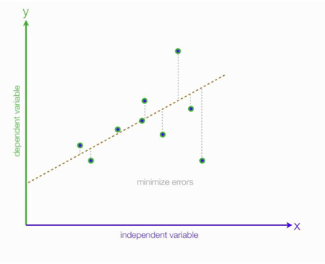
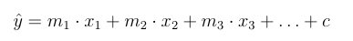
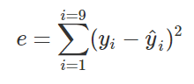
Linear Regression
Estimating Linear Regression Coefficients
9 observations index from 1 to 9
Model:
y^₉
error
} error₉ = y₉-y^₉
Model
y^₉
y is the actual output (y_{1,} y_{2,} y_{3….} y₉)
x is the independent variable (x_{1,} x_{2,} x_{3….} x₉)
y^ is the model/estimated/calculate output
(y^_{1,} y ^ _{2,} y ^ _{3….} y ^ ₉)
Actual
y₉
(x₉,y₉)
x₉
Total Error =
e = e1+e2+e3+…+e9
e = (y₁₋ y^₁) + (y₂₋ y^₂) + (y₃₋ y^₃) +… + (y₉₋ y^₉)

Slide 10
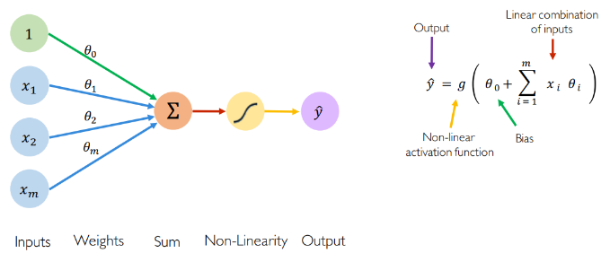
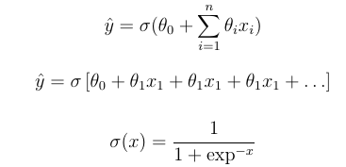
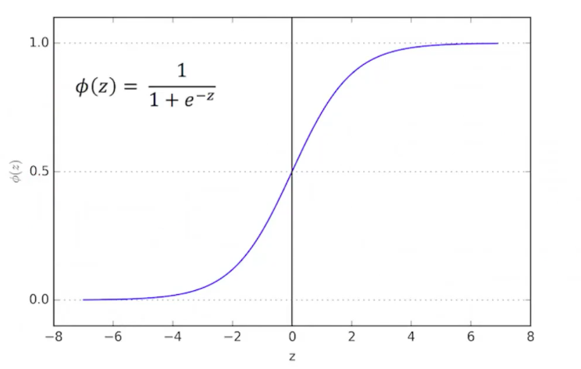
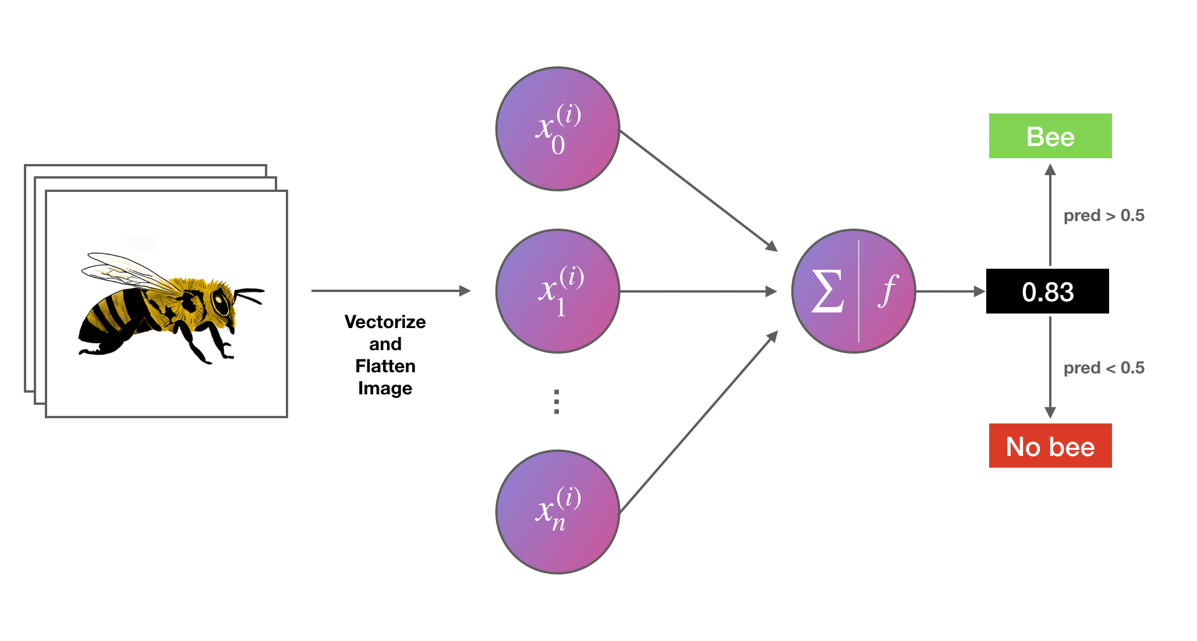
Logistic Regression
Estimating Logistic Regression Coefficients
Model:

Slide 11
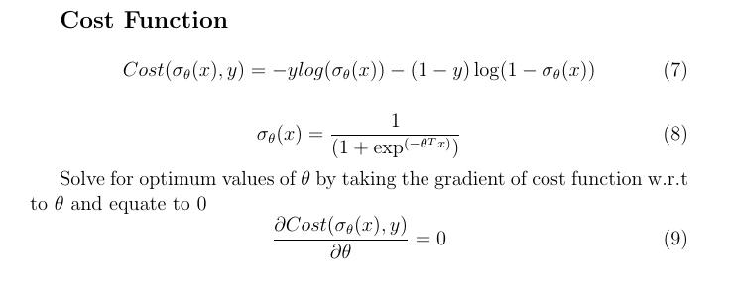
Logistic Regression
Estimating Logistic Regression Coefficients

Slide 12
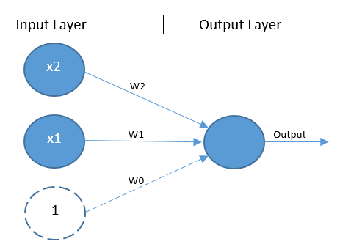
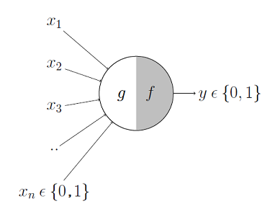
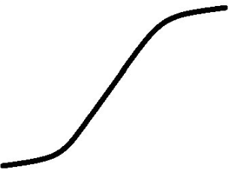
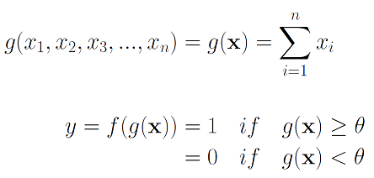
AI Introduction: Simple Perceptron/Neuron
https://towardsdatascience.com/mcculloch-pitts-model-5fdf65ac5dd1

Slide 13
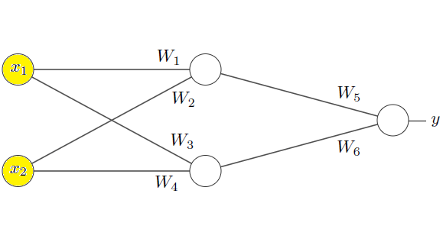
AI Introduction: Simple Perceptron/Neuron
Neural Networks are Series of Logistic Regressions put together in a series.
Number of Logistic Regression Units are Dependent on complexity of the task is being learnt
In the diagram below, how many neurons or perceptron do you see?

Slide 14
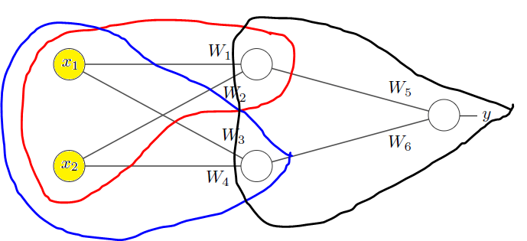
AI Introduction: Simple Perceptron/Neuron
Neural Networks are Series of Logistic Regressions put together in a series.
Number of Logistic Regression Units are Dependent on complexity of the task is being learnt
In the diagram below, how many neurons or perceptron or Logistic Regression Units do you see?
https://towardsdatascience.com/mcculloch-pitts-model-5fdf65ac5dd1

Slide 15
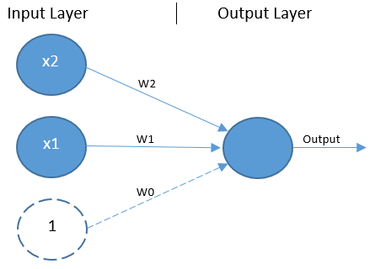
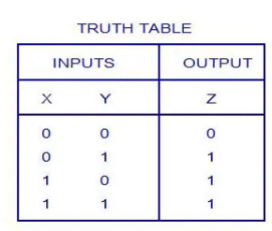
Neural Network Simulating OR Logic Gate
OR Gate |  |  |  |  | x1*w1+x2*w2+b | 1/(1+exp(-x))
X1 | X2 | w1 | w2 | bias | sum(X) | sig(X) | Y (output)
0 | 0 | 1.5 | 1.5 | -1 | -1 | 0.2689 | 0
1 | 0 | 1.5 | 1.5 | -1 | 0.5 | 0.5 | 1
0 | 1 | 1.5 | 1.5 | -1 | 0.5 | 0.5 | 1
1 | 1 | 1.5 | 1.5 | -1 | 2 | 0.88 | 1
For inputs x1=1, x2=2
Sum(x) = w1*x1 + w2*x2 + bias = 1*1.5 + 1*1.5-1 = 2
Sigmoid(2) = 0.88
which is > 0.5, therefore output it 1
https://towardsdatascience.com/mcculloch-pitts-model-5fdf65ac5dd1

Slide 16
Neural Network Simulating OR Logic Gate
1
1
1
0
1
0
1
https://towardsdatascience.com/mcculloch-pitts-model-5fdf65ac5dd1

Slide 17
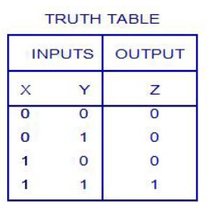
Neural Network Simulating AND Logic Gate
And Gate |  |  |  |  | x1*w1+x2*w2+b | 1/(1+exp(-x))
X1 | X2 | w1 | w2 | bias | sum(X) | sig(X) | Y (output)
0 | 0 | 1 | 1 | -1.2 | -1.2 | 0.2689 | 0
1 | 0 | 1 | 1 | -1.2 | -0.2 | 0.45 | 0
0 | 1 | 1 | 1 | -1.2 | -0.2 | 0.45 | 0
1 | 1 | 1 | 1 | -1.2 | 0.8 | 0.6899 | 1
For inputs x1=0, x2=1
Sum(x) = w1*x1 + w2*x2 + bias = 0*1 + 1*1-1.2 = -0.2
Sigmoid(-0.2) = 0.45
0.45 < 0.5, therefore output it 0
https://towardsdatascience.com/mcculloch-pitts-model-5fdf65ac5dd1

Slide 18
Neural Network Simulating AND Logic Gate
0
1
1
0
0
0
1
https://towardsdatascience.com/mcculloch-pitts-model-5fdf65ac5dd1

Slide 19
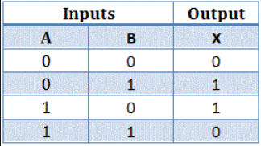
Neural Network Simulating XOR Logic Gate
Can you draw the boundary line separating out output classes 1 and 0?
1
0
1
0
1
0
1
https://towardsdatascience.com/mcculloch-pitts-model-5fdf65ac5dd1

Slide 20
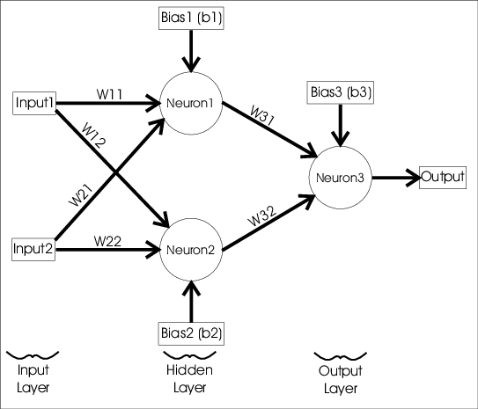
Neural Network Simulating XOR Logic Gate
Hidden Layer
https://towardsdatascience.com/mcculloch-pitts-model-5fdf65ac5dd1

Slide 21
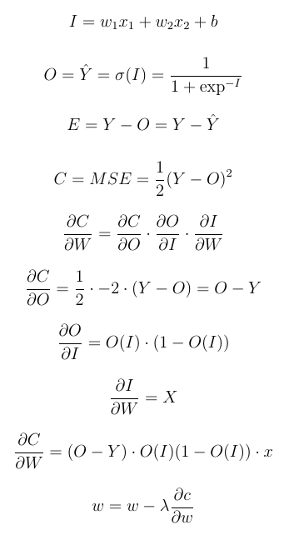
Neural Network OR/AND/NOT Gate Derivations
b
x1
w1
I
O
∑
σ
x2
w2

Slide 22
Neural Network XOR Gate Derivations
W1 = [w₁11 w₁21
w₁12 w₁22]
W2 = [w₂11 w₂21]
A1 = [a11 a12]
W₁11
z11
a11
A2 = [a21]
X1
w₂11
W₁12
W₁21
z21
a21
w₂21
z12
a12
X2
W₁22
Z1 = W1^{T}X+b1
A1 = sigmoid(Z1)
Z2 = W1^{T}A1+b2
A2 = sigmoid(Z2)

Slide 23
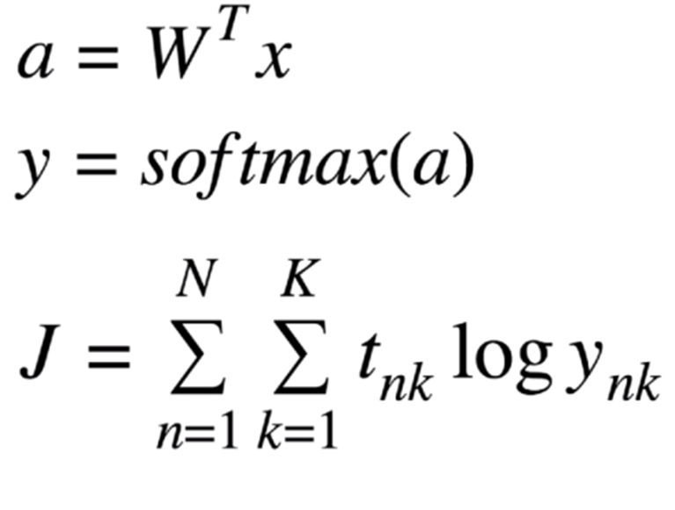
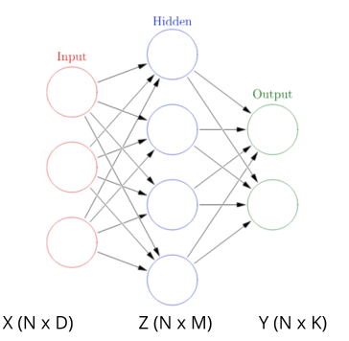
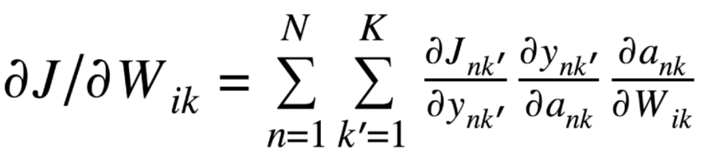
Neural Network Simulating XOR Logic Gate
https://towardsdatascience.com/mcculloch-pitts-model-5fdf65ac5dd1

Slide 24
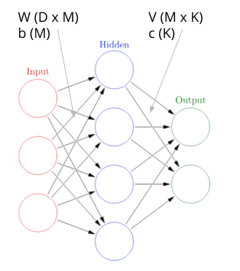
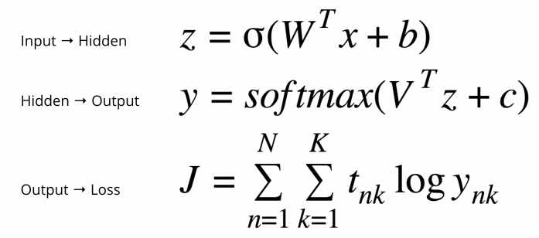
Neural Network Simulating XOR Logic Gate
https://towardsdatascience.com/mcculloch-pitts-model-5fdf65ac5dd1

Slide 25
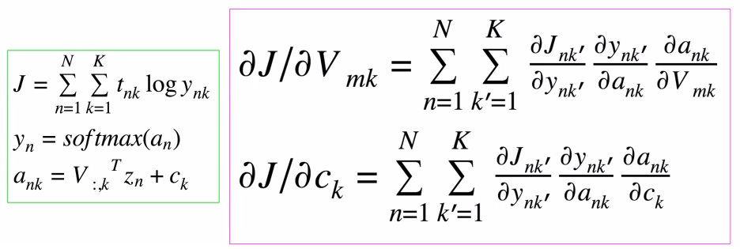
Neural Network Simulating XOR Logic Gate
https://towardsdatascience.com/mcculloch-pitts-model-5fdf65ac5dd1

Slide 26
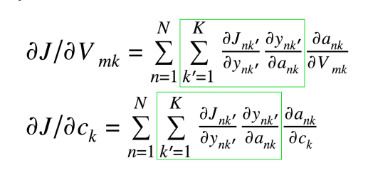
Neural Network Simulating XOR Logic Gate
https://towardsdatascience.com/mcculloch-pitts-model-5fdf65ac5dd1

Slide 27
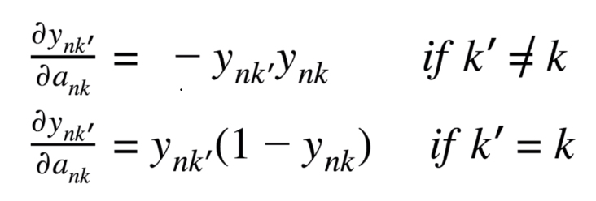
Neural Network Simulating XOR Logic Gate
https://towardsdatascience.com/mcculloch-pitts-model-5fdf65ac5dd1

Slide 28
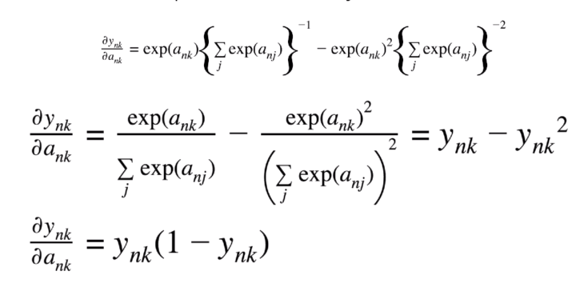
Neural Network Simulating XOR Logic Gate
https://towardsdatascience.com/mcculloch-pitts-model-5fdf65ac5dd1

Slide 29
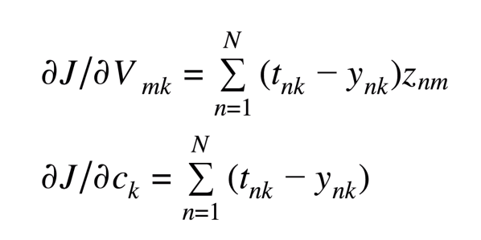
Neural Network Simulating XOR Logic Gate
https://towardsdatascience.com/mcculloch-pitts-model-5fdf65ac5dd1

Slide 30
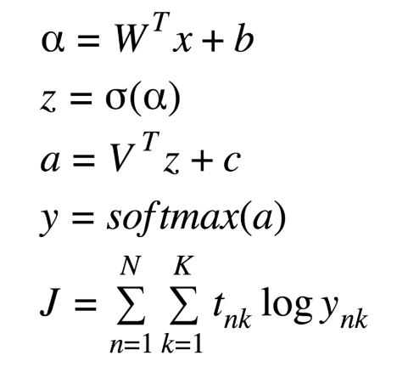
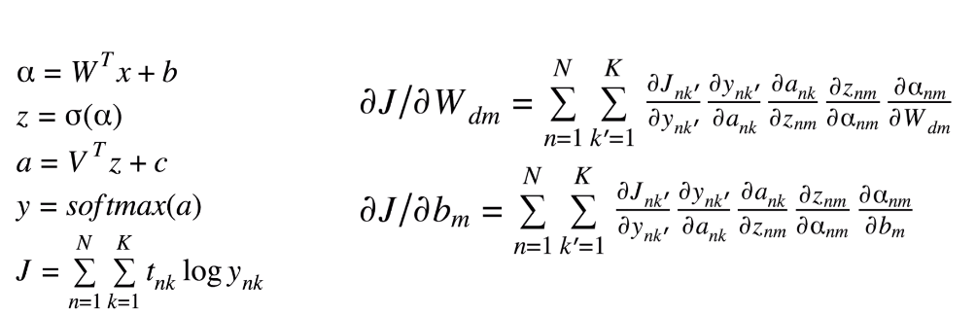
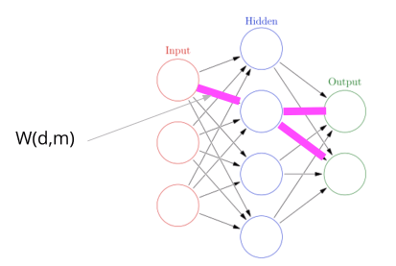
Neural Network Simulating XOR Logic Gate
https://towardsdatascience.com/mcculloch-pitts-model-5fdf65ac5dd1

Slide 31
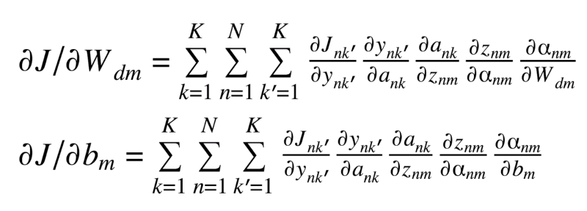
Neural Network Simulating XOR Logic Gate
https://towardsdatascience.com/mcculloch-pitts-model-5fdf65ac5dd1

Slide 32
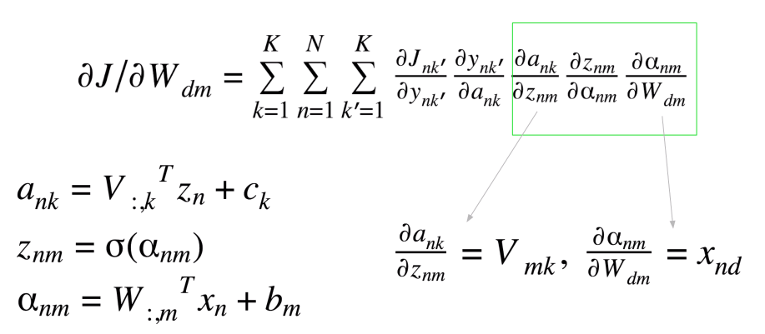
Neural Network Simulating XOR Logic Gate
https://towardsdatascience.com/mcculloch-pitts-model-5fdf65ac5dd1

Slide 33
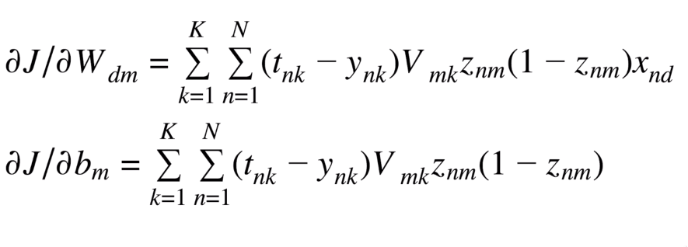
Neural Network Simulating XOR Logic Gate
https://towardsdatascience.com/mcculloch-pitts-model-5fdf65ac5dd1

Slide 34
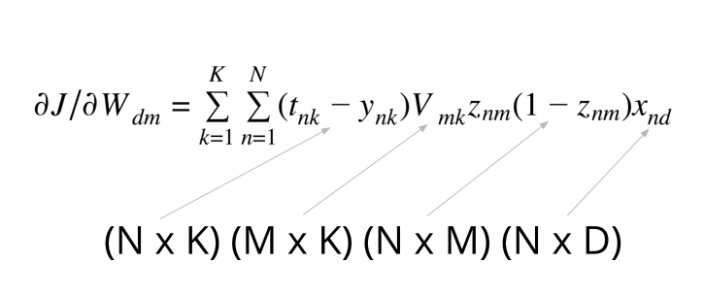
Neural Network Simulating XOR Logic Gate
https://towardsdatascience.com/mcculloch-pitts-model-5fdf65ac5dd1

Slide 35
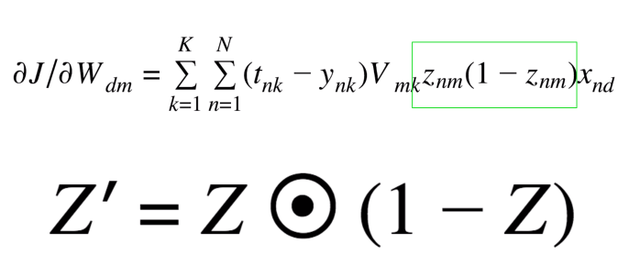
Neural Network Simulating XOR Logic Gate
https://towardsdatascience.com/mcculloch-pitts-model-5fdf65ac5dd1

Slide 36
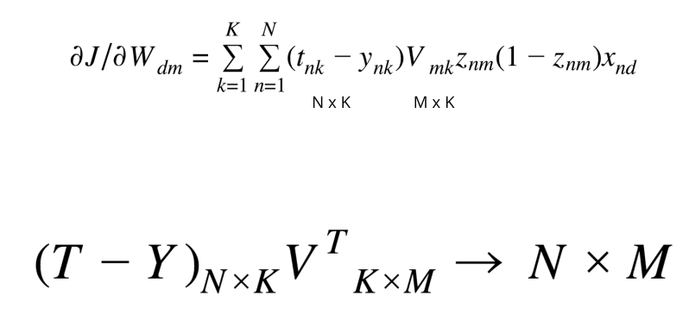
Neural Network Simulating XOR Logic Gate
https://towardsdatascience.com/mcculloch-pitts-model-5fdf65ac5dd1

Slide 37
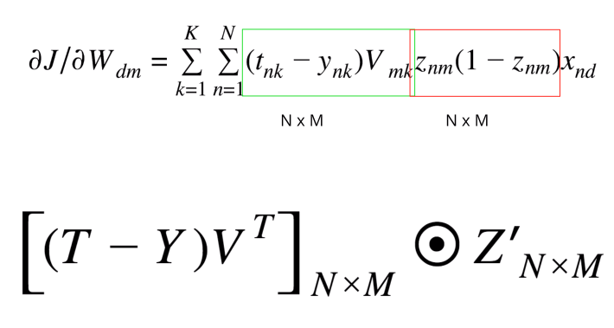
Neural Network Simulating XOR Logic Gate
https://towardsdatascience.com/mcculloch-pitts-model-5fdf65ac5dd1

Slide 38
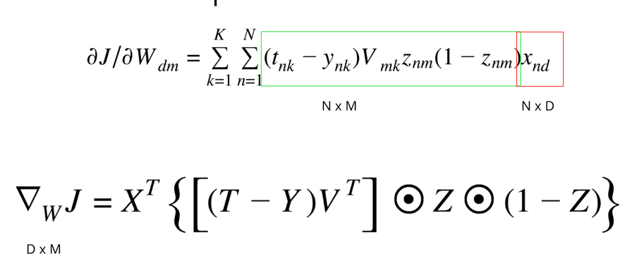
Neural Network Simulating XOR Logic Gate
https://towardsdatascience.com/mcculloch-pitts-model-5fdf65ac5dd1

Slide 39
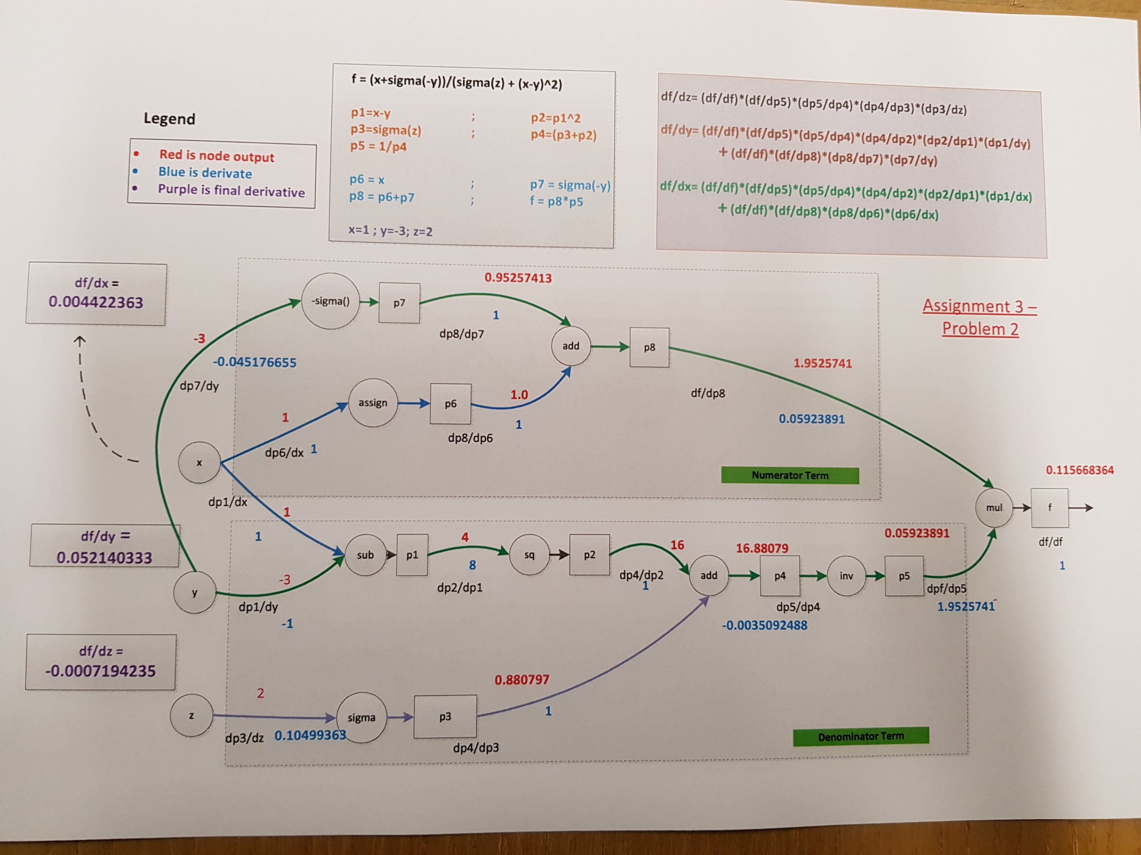
Neural Network Simulating XOR Logic Gate
https://towardsdatascience.com/mcculloch-pitts-model-5fdf65ac5dd1

